Slide 1


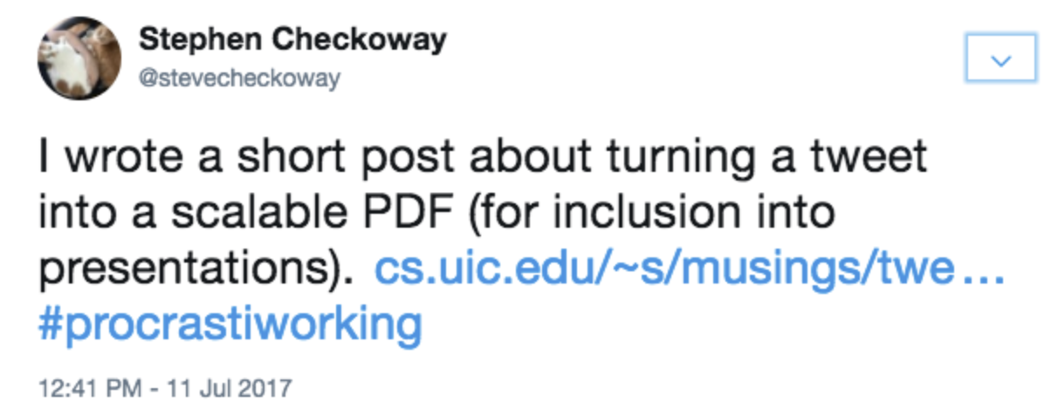
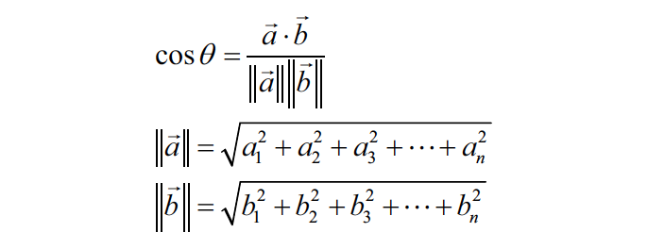
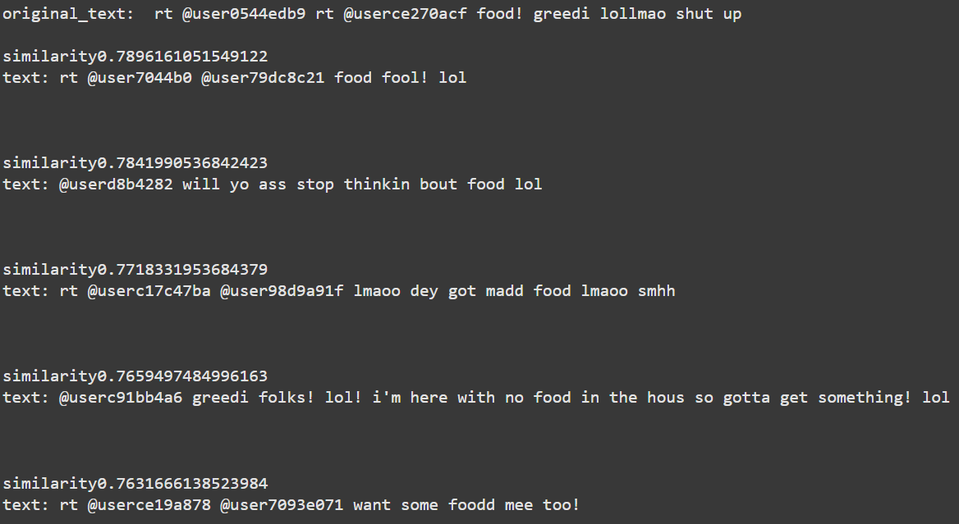
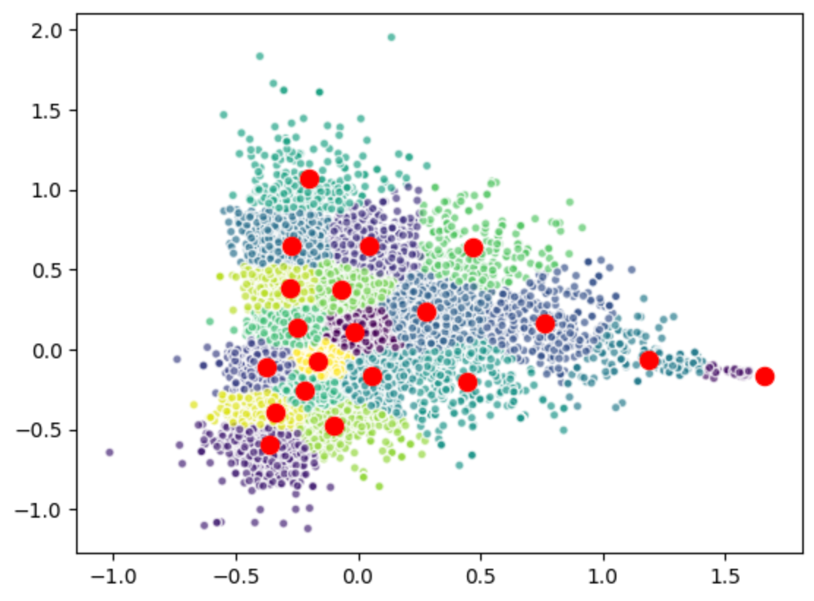
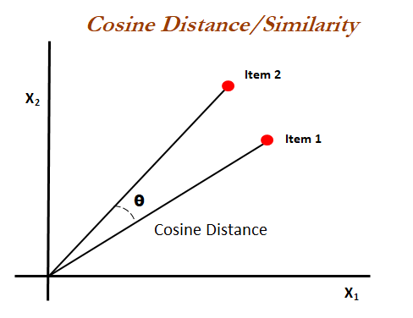
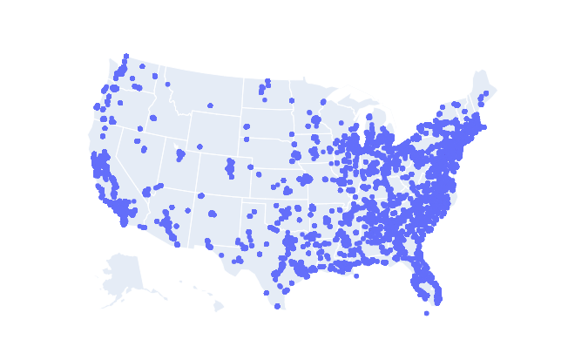
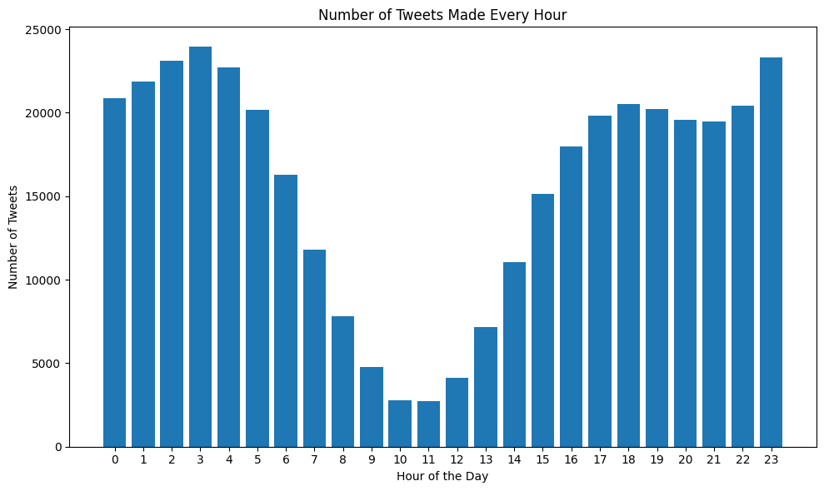

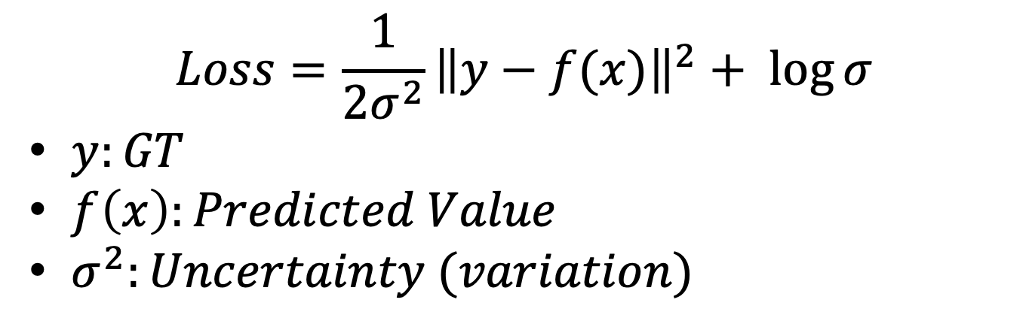
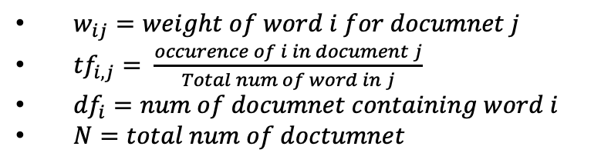
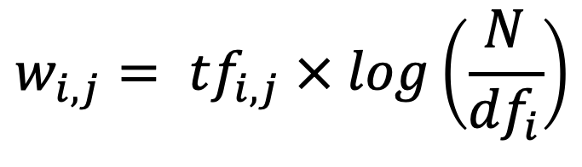
Prediction Geolocation based on social media data
Jongbum Choi, Tanvir Alam, Devansh Shah,
Dinisha Surywa, Evelyn Rose
The University of Texas at San Antonio
Introduction
Methodology
Predict Region & State
Goal:
Develop Various Transfromer Language Model based Application
1. Predict Geolocation
2. Sentiment Analysis
3. Recommendation
Preprocessing Algorithm for Social Media Data
Pipeline of Two Cascading Models
1st Model: Predict Region and State
2nd Model: Predict Location
TF-IDF & Linear SVC for Region & State
Vectorization: TF-IDF
Vector Classification: Linear SVC
TF-IDF Machine Learning Model
Statistical formula to Convert text doc into vectors
Linear SVC (Support Vector Classifier)
1st Model: Text → 9 Regions
2nd Model: 9 Regions → State
$$w_{i,j}= {tf}_{i,j} × log\left(\frac{N}{{df}_{i}}\right)$$
$w_{ij}=weight of word i for documnet j$
${tf}_{i,j}= \frac{occurence of i in document j}{Total num of word in j}$
${df}_{i}=num of documnet containing word i$
$N=total num of doctumnet$
Predict Location
Recommendation
PreProcessing
Mean & Uncertainty(Variation)¹ of Location
$$Loss=\frac{1}{2σ^{2}}{\left\|y−f(x)\right\|}^{2}+ \log{σ}$$
$y:GT$
$f\left(x\right):Predicted Value$
$σ^{2}:Uncertainty (variation)$
Vectorized tweet(text) Clustering
Generate sentence embeddings by pre-trained BERT model
Sentence Embedding with Cosine Distance
Find recommend top 5 related posts
Statistical DB analysis
Geographical, Tweet Time Distribution
Noise and Outlier analysis & Cleaning
Remove Emoji, punctuations
Non-US DB Translation
+ State Info
Foundation Model
Tokenizer
BERT
Model
(Batch, 768)
Our Model
Location
Model
Test Result
Avg Error: 168.42 km
High Variation Avg Error: 401.66 km
(e.g “I don’t feel so good today!”, ”I am home now.”)
Low Variation Avg Error: 34.88km
(e.g “I am in the river walk”, “New york, New york!!”)
(Mean, Variation)
of Location
BERT Model
¹Multi-Task Learning Using Uncertainty to Weigh Losses for Scene Geometry and Semantics
Conclusion
ProProcessing
Provide valuable insights (statistical approach)
Cleaning is Crucial Related model performance.
Model
Machin Learning Model is good option for Text Classification
BERT Model: Provides vector information applicable to various applications.
(e.g., Geolocation Prediction, Sentiment and Recommendation)
Mean and Uncertainty: provide a range of values instead of a single figure for the model.
< Geographical Distribution: Tweets >
< Tweets Made Every Hour >
It’s decided. Getting a tattoo.

